Slide 1

Azure Developer – Virtual Mentored Program
Azure Functions, API Management, & Azure CosmosDB

Slide 2
Week 3 Content
Azure Functions (Part 2)
API Management
Azure CosmosDB

Slide 3
Azure Functions (Part 2)

Slide 4
Infrastructure-as-a-Service (IaaS)
Involves the building out (and management) of virtual instances of:
Compute
Network
Storage
Akin to spinning up a server (physical or virtual) in your location or data center complete with disks and required network connectivity
The difference is in the where – instead of in your data center, it is created in a data center managed by one of the public Cloud providers
Your organization is responsible for patching the OS, ensuring all appropriate security updates are applied and that the right controls are in place to govern interaction between this set of components and other infrastructure

Slide 5
Platform-as-a-Service (PaaS)
Involves leveraging managed services from a public Cloud provider
With this model, an enterprise can focus on management of their application and data vs. focusing on management of the underlying infrastructure
Patching and security of the infrastructure used to back the managed services falls to the CSP (Cloud Service Provider)
Many managed services support automatic scale up or down depending on demand to help ensure sufficient capacity is in place
Part of what is often termed the “Shared Responsibility Model”

Slide 6
Serverless / Functions-as-a-Service (FaaS)
Also represents a type of managed service provided by the CSP
Cost structure is usually consumption-based (i.e., you only pay for what you use)
Supports many different coding paradigms (C#/.NET, NodeJS, Python, etc.)
Typically, with Serverless (and PaaS), the consumer is only concerned with the application code and data – elements of the CSP’s “backbone” used to support are managed by the CSP
Includes more sophisticated automated scaling capabilities – built for Internet scale

Slide 7
Software-as-a-Service (SaaS)
Subscription-based application services
Licensed for utilization over the Internet / online rather than for download and install on a server or client machine
Fully-hosted and fully-managed by a 3rd party
Of those discussed, often the cheapest option for service consumers
However, also offers minimal (or no) control, outside of exposed configuration capabilities

Slide 8
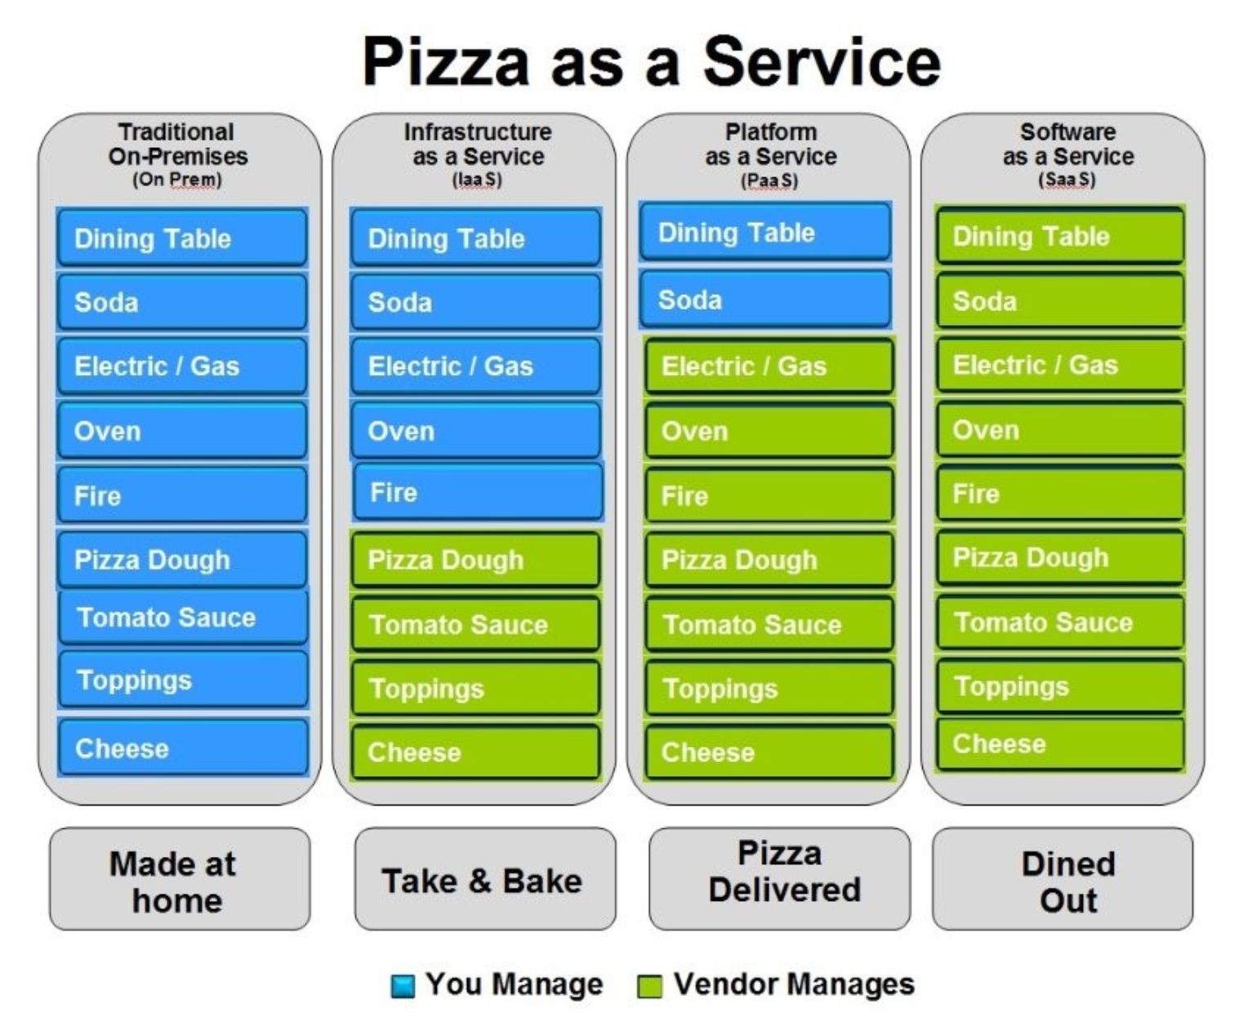

Pizza-as-a-Service
From a LinkedIn post by Albert Barron from IBM (https://www.linkedin.com/pulse/20140730172610-9679881-pizza-as-a-service/)

Slide 9
Cloud Service Models
On-Prem
IaaS
PaaS / Serverless
SaaS
Servers
Servers
Servers
Servers
Storage
Storage
Storage
Storage
Customer
Networking
Networking
Networking
Networking
CSP
Virtualization
Virtualization
Virtualization
Virtualization
Control
Physical Security
Physical Security
Physical Security
Physical Security
OS
OS
OS
OS
Middleware
Middleware
Middleware
Middleware
Runtime
Runtime
Runtime
Runtime
Application
Application
Application
Application
Data
Data
Data
Data
Transfer of Responsibility

Slide 10
Azure Functions
One of Microsoft’s serverless offerings on Azure
As with other serverless offerings, enables focus on application and data (not infrastructure)
Can implement logic (in multiple languages) in code blocks called “functions”
Supports multiple types of “triggers”
Scales automatically to address increases in demand
Notes:
There are other serverless options (e.g., Azure Logic Apps)
Obviously, there’s a server running “somewhere”
Triggers are the events that cause the function to run
Triggers can include add of item to storage account, HTTP request, etc.

Slide 11
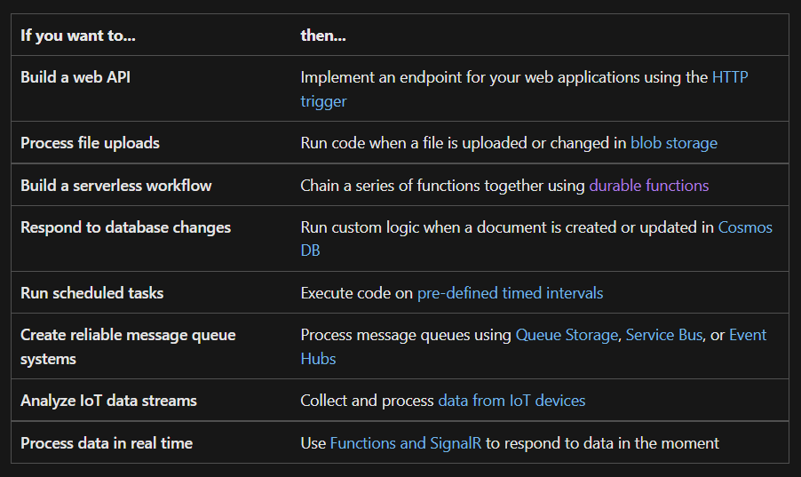
Azure Functions
Source: https://docs.microsoft.com/en-us/azure/azure-functions/functions-overview
Notes:
Not an exhaustive list – multiple options available

Slide 12
Durable Functions
Extension of Azure Functions
Supports stateful functions that can be integrated into orchestrated workflows or entity management algorithms
As with Azure Functions, supports multiple programming languages
Also supports multiple patterns
See https://docs.microsoft.com/en-us/azure/azure-functions/durable/durable-functions-overview for more info

Slide 13
Hosting Plans
Azure Functions offers multiple types of hosting plans
Hosting plan drives other features of function app (like scalability, available timeouts, service limits, etc.)
See https://docs.microsoft.com/en-us/azure/azure-functions/functions-scale for more info

Slide 14
Azure Functions
Demo
Notes:
https://docs.microsoft.com/en-us/azure/azure-functions/functions-machine-learning-tensorflow
Apply machine learning models in Azure Functions with Python and TensorFlow

Slide 15
Azure Functions
Lab
Notes:
https://docs.microsoft.com/en-us/azure/azure-functions/create-first-function-vs-code-csharp?tabs=in-process
Create a C# function in Azure using Visual Studio Code
https://docs.microsoft.com/en-us/azure/azure-functions/create-first-function-vs-code-java
Create a Java function in Azure using Visual Studio Code
https://docs.microsoft.com/en-us/azure/azure-functions/create-first-function-vs-code-python
Create a function in Azure with Python using Visual Studio Code

Slide 16
API Management

Slide 17
What is an API?
Stands for Application Programming Interface
Describes the public interface exposed by one or more components
Enables the reuse of functionality across multiple workflows
Allows us to break a larger problem into smaller pieces
Often “bound” by the specific technology used for connectivity and interaction

Slide 18


Information Exchange
Contract
API Consumer
API Producer
APIs:
Model the exchange of information between a consumer & producer
Support business integration between two internal systems (“in process”) or between an internal system & an external partner (“out of process”)
Built around technology specifications for interaction & type definition
Enable integration over the network/Internet

Slide 19



API Value Proposition
Make data accessible
Enable integration, collaboration, & reuse
Simplify & accelerate implementation
Notes:
Monetization can also be a value proposition but focusing more in this session on internal access/value

Slide 20
Make Data Accessible
In today’s “digital age”, data often represents an organization’s competitive advantage
Includes:
Knowing what data is available
Knowing where to find it
Having a way to access it & use it that is secure
Data can be used to drive business intelligence, business vision, & business execution
Learning things from our historical data that can be used to infer the most profitable paths to take going forward
Knowledge (data) is power!
APIs are a means to data accessibility

Slide 21
Enable Integration, Collaboration, & Reuse
Siloes (in business or technology) can hinder our ability to maximize efficiencies
Rebuilding the same functionality over again (possibly differently from previous implementations) is sub-optimal
Can result in a significant waste of resources & lead to errors costing us valuable time in the race to be “first & best”
Large organizations can suffer from “the left hand doesn’t know what the right hand is doing”
A consumable catalog of available services, the data they provide, and owners promotes cross-team collaboration toward common business goals
APIs provide vehicles for integration, collaboration, & reuse

Slide 22
Simplify & Accelerate Implementation
Simplicity breeds speed
To be as efficient & as effective as possible, we seek to minimize “accidental complexity” in favor of “essential complexity”
Minimizing accidental complexity includes driving out redundancy & waste
It also includes streamlining our approach across the enterprise to accessing & leveraging specific types of commodity detail in consistent ways
Paving the way to focus on essential complexity allows us to focus on value-added activities that drive innovation
APIs helps us accelerate implementation by providing “building blocks” that can be organized in different ways to solve new business problems

Slide 23
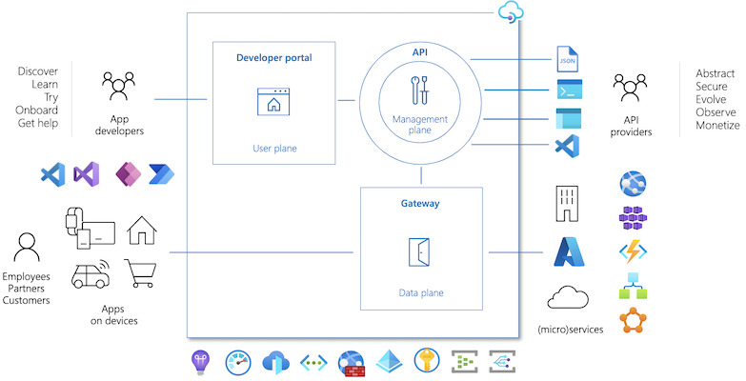
API Management
Source: https://docs.microsoft.com/en-us/azure/api-management/api-management-key-concepts
Notes:
There are other serverless options (e.g., Azure Logic Apps)
Obviously, there’s a server running “somewhere”
Triggers are the events that cause the function to run
Triggers can include add of item to storage account, HTTP request, etc.

Slide 24





Capabilities Provided by an API Gateway
Reduce coupling between API consumer & API producer
Aggregate & translate backends to simplify consumption
Detect & help mitigate security threats
Promote observability, traceability, & visibility
Support the API lifecycle

Slide 25
Reduce Coupling Between API Consumer & Producer
API Gateway provides an intermediary between a consumer & one or more data producers
Helps to reduce coupling as consumer only needs to know about the gateway, not all the underlying API endpoints used to service the request

Slide 26
Aggregate & Translate Backends to Simplify Consumption
API Gateway can be used to aggregate results from multiple data sources into a single, unified contract
Able to support various types of translation between consumer & producer (if required)
Can include protocol translation, message format translation, etc.

Slide 27
Detect & Help Mitigate Security Threats
API Gateway can provide first line of defense for incoming requests
Can include specific security protections like TLS termination, AuthN/AuthZ, & access management at the IP level
Can provide helpful features like request throttling to protect against DDoS

Slide 28
Promote Observability, Traceability, & Visibility
API Gateway can provide detail crucial to measuring & tracking metrics & Key Performance Indicators (KPIs) relative to API usage & consumption
Can be used to automatically inject correlation IDs (e.g., GUIDs) for end-to-end traceability
Detail gleaned from monitoring can help inform proper security configuration

Slide 29
Support the API Lifecycle
API Gateway can support formal lifecycle management of APIs as products
Plan
Deploy
Configure
Monitor
Retire
API Gateway & Management factor into each lifecycle phase

Slide 30
API Management
Demo
Notes:
https://docs.microsoft.com/en-us/azure/api-management/get-started-create-service-instance-cli
Create a new Azure API Management service instance by using the Azure CLI
https://docs.microsoft.com/en-us/azure/api-management/import-and-publish
Import and publish your first API
https://docs.microsoft.com/en-us/azure/api-management/transform-api Transform and protect your API

Slide 31
Azure CosmosDB

Slide 32
Azure Cosmos DB
Provides a fully managed NoSQL database platform
NoSQL is the model used when the data to be stored does not fit a strict schema (or structure)
Built around the concept of storing data as “documents” – hierarchical sets of key/value data that describe an entity
JSON (or JavaScript Object Notation) is a common document format used for storage

Slide 33
Azure Cosmos DB
Intended for all types of application use cases
Provides very fast data access, elastic scalability, and global availability
Built into the service offering is support for deployment to multiple regions across the world, enabling low latency access for users to locations closest in proximity

Slide 34
Azure Cosmos DB – Resource Model
Within an Azure subscription, a new Cosmos DB account can be created
Within the Cosmos DB account, data is stored and organized using a defined hierarchy
Databases
Contain
Containers
Contain
Items

Slide 35
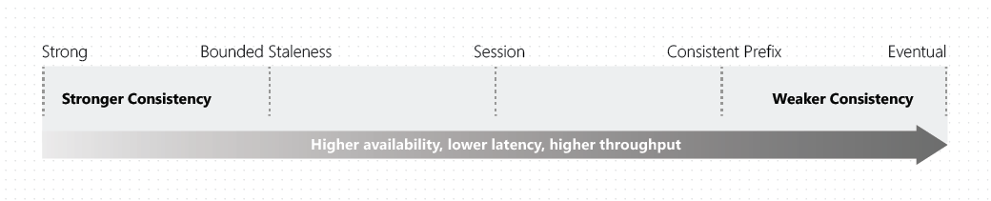
Consistency Levels
With multiple replicas of your data distributed globally, consistency defines how in sync the replicas remain and how quickly out-of-sync issues are corrected
There are 5 levels provided by Cosmos DB
Each level provides tradeoffs in terms of data sync and performance
Source: https://docs.microsoft.com/en-us/azure/cosmos-db/consistency-levels
Notes:
Globally across multiple regions

Slide 36
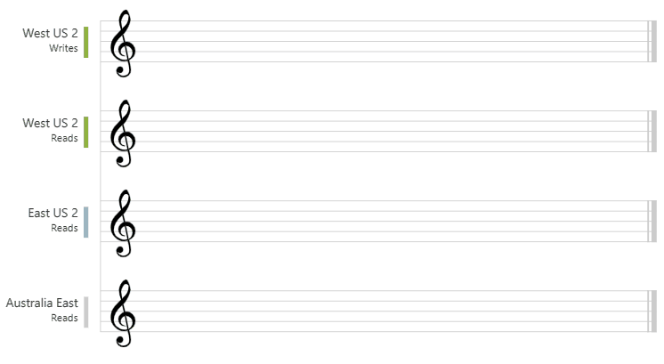
Strong Consistency
Source: https://docs.microsoft.com/en-us/azure/cosmos-db/consistency-levels
Notes:
After the data is written to the "West US 2" region, when you read the data from other regions, you get the most recent value. Highest latency as write operation must wait until data is written to/available in all replicas (regions).

Slide 37
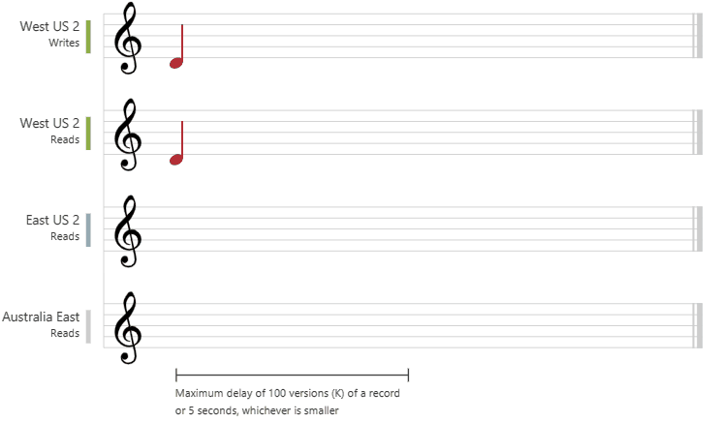
Bounded Staleness
Source: https://docs.microsoft.com/en-us/azure/cosmos-db/consistency-levels
Notes:
After the data is written to the "West US 2" region, the "East US 2" and "Australia East" regions read the written value based on the configured maximum lag time or the maximum operations.

Slide 38
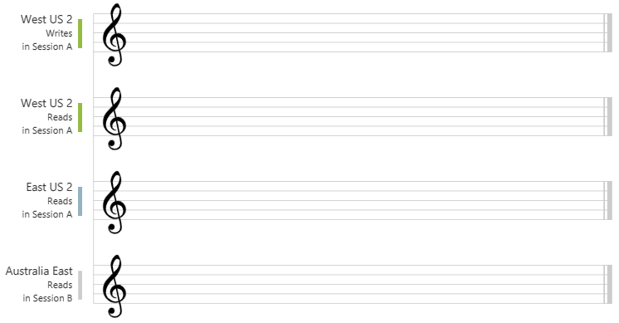
Session
Source: https://docs.microsoft.com/en-us/azure/cosmos-db/consistency-levels
Notes:
The "West US 2 writer" and the "West US 2 reader" are using the same session (Session A) so they both read the same data at the same time. Whereas the "Australia East" region is using "Session B" so, it receives data later but in the same order as the writes.

Slide 39
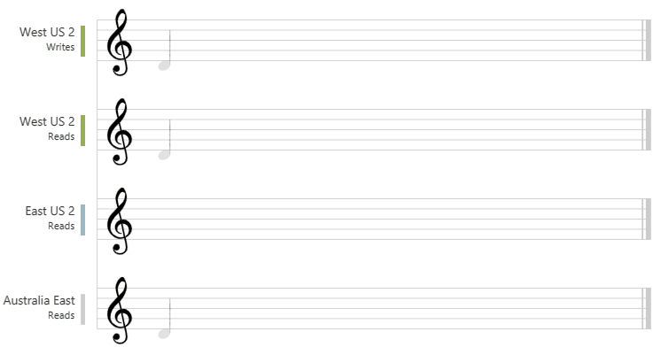
Consistent Prefix
Source: https://docs.microsoft.com/en-us/azure/cosmos-db/consistency-levels
Notes:
In all the regions, the reads never see out of order writes even though the data for read may not be immediately available.

Slide 40
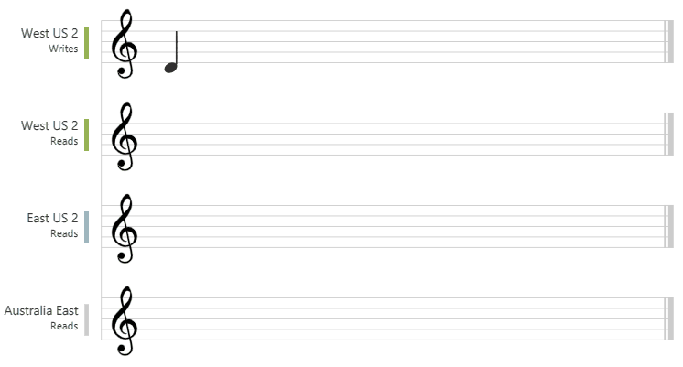
Eventual
Source: https://docs.microsoft.com/en-us/azure/cosmos-db/consistency-levels
Notes:
No ordering guarantee for reads. Weakest form but highest performing – eventually (hence the name) read replicas will match what was written but it will take time.

Slide 41
Azure Cosmos DB – APIs Supported
Core/SQL API
API for MongoDB
Cassandra API
Gremlin API
Table API
Notes:
Core/SQL API - Supports SQL (Structure Query Language) syntax for accessing data
API for MongoDB – Maintains consistency with the MongoDB platform, a well-known and popular NoSQL platform in use today
Cassandra API – Maintains consistency with Apache Cassandra and its tooling
Gremlin API – Supports graph-based data storage and retrieval – graph-based used to define hierarchical structures like org charts
Table API – Provides storage and access for data in simple key/value format

Slide 42
Azure CosmosDB
Demo
Notes:
https://docs.microsoft.com/en-us/azure/cosmos-db/sql/sql-api-get-started
Review throughput limits – cost management + policy

Slide 43
Azure CosmosDB
Lab
Notes:
https://docs.microsoft.com/en-us/azure/cosmos-db/sql/quickstart-dotnet
Azure Cosmos DB SQL API client library for .NET
https://docs.microsoft.com/en-us/azure/cosmos-db/sql/create-sql-api-spring-data
Build a Spring Data Azure Cosmos DB v3 app to manage Azure Cosmos DB SQL API data
https://docs.microsoft.com/en-us/azure/cosmos-db/sql/create-sql-api-python
Build a Python application using an Azure Cosmos DB SQL API account

Slide 44




Best of luck as you forge ahead on your Cloud journey!

